Slide 1

CS 4048 Data Science
Instructor: Dr. Kashif Zafar
January 29, 2026
$χ^{2}$ (Chi-Square) test
Lecture No. 2d

Slide 2
$χ^{2}$Correlation for Nominal Data
Suppose that a group of 1500 people was surveyed.
The gender of each person was noted. Each person was polled as to whether his or her preferred type of reading material was ﬁction or nonﬁction.
Thus, we have two attributes, gender and preferred reading.
The observed frequency (or count) of each possible joint event is summarized in the contingency table

Slide 3
$χ^{2}$Correlation for Nominal Data
 | male | female | Total
fiction
non-fiction
Total

Slide 4


$χ^{2}$Correlation for Nominal Data
 | male | female | Total
fiction | 250 | 200 | 450
non-fiction | 50 | 1000 | 1050
Total | 300 | 1200 | 1500
1- Find expected values for this contingency Table
$$e_{11}=\frac{count\left(male\right)×count\left(fiction\right)}{n}$$
$$e_{11}=\frac{300×450}{1500}=90$$
 | male | female
fiction | 90
non-fiction

Slide 5


$χ^{2}$Correlation for Nominal Data
 | male | female | Total
fiction | 250 | 200 | 450
non-fiction | 50 | 1000 | 1050
Total | 300 | 1200 | 1500
1- Find expected values for this contingency Table
$$e_{12}=\frac{count\left(female\right)×count\left(fiction\right)}{n}$$
$$e_{12}=\frac{1200×450}{1500}=360$$
 | male | female
fiction | 90 | 360
non-fiction

Slide 6

$χ^{2}$Correlation for Nominal Data
 | male | female | Total
fiction | 250 | 200 | 450
non-fiction | 50 | 1000 | 1050
Total | 300 | 1200 | 1500
1- Find expected values for this contingency Table
$$e_{12}=\frac{count\left(female\right)×count\left(fiction\right)}{n}$$
$$e_{12}=\frac{1200×450}{1500}=360$$
 | male | female
fiction | 90 | 360
non-fiction | 210 | 840

Slide 7

$χ^{2}$Correlation for Nominal Data
 | male | female | Total
fiction | 250 | 200 | 450
non-fiction | 50 | 1000 | 1050
Total | 300 | 1200 | 1500
 | male | female
fiction | 90 | 360
non-fiction | 210 | 840
2- Compute $χ^{2}$
$$χ^{2}=\frac{{\left(250−90\right)}^{2}}{90}+\frac{{\left(50−210\right)}^{2}}{210}+\frac{{\left(200−360\right)}^{2}}{360}+\frac{{\left(1000−840\right)}^{2}}{840}$$
$$χ^{2}=284.44+121.90+71.11+30.48=507.93$$

Slide 8
$χ^{2}$Correlation for Nominal Data
 | male | female | Total
fiction | 250 (90) | 200 (360) | 450
non-fiction | 50 (210) | 1000 (840) | 1050
Total | 300 | 1200 | 1500
2- Compute $χ^{2}$
$$χ^{2}=\frac{{\left(250−90\right)}^{2}}{90}+\frac{{\left(50−210\right)}^{2}}{210}+\frac{{\left(200−360\right)}^{2}}{360}+\frac{{\left(1000−840\right)}^{2}}{840}$$
$$χ^{2}=284.44+121.90+71.11+30.48=507.93$$

Slide 9


$χ^{2}$Analysis
The larger the $χ^{2}$ value, the more likely the variables are related
The cells that contribute the most to the $χ^{2}$ value are those whose actual count is very different from the expected count
Remember: Correlation does not imply causality
Null Hypothesis: There is no relation between “gender” and “preferred reading ”
Alternate Hypothesis: There is significant relation between “gender” and “preferred reading ”
$$χ^{2}=507.93$$
$$Significance Level \left(∝\right)=0.05 (5\%)$$
$$Degree of Freedom=\left(columns−1\right)×\left(rows−1\right)=(2−1)×(2−1)=1$$

Slide 10
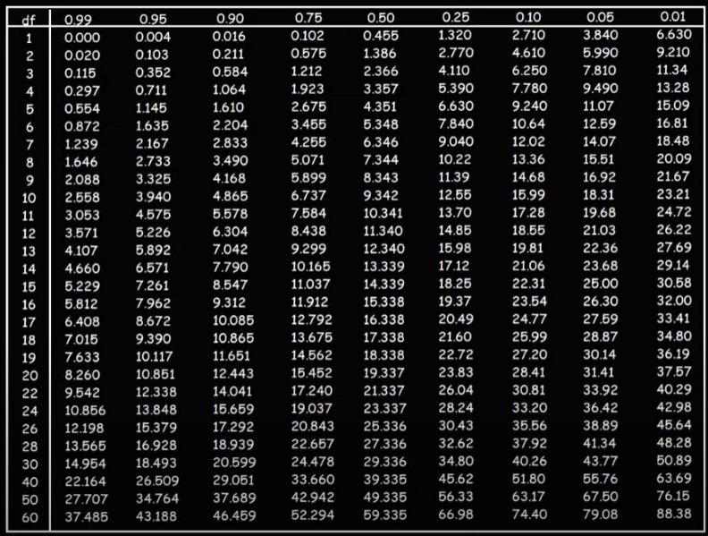





$χ^{2}$Analysis
$$Significance Level \left(∝\right)=0.05 (5\%)$$
$$χ^{2}=507.93$$
$$Degree of Freedom=1$$
$$χ_{calculated}^{2}>χ_{tabular}^{2}$$
$∴$we reject Null hypothesis and accept alternate hypothesis

Slide 11
$χ^{2}$Analysis
Since our computed value is above the tabular value, we can reject the hypothesis that “gender” and “preferred reading ” are independent and conclude that the two attributes are (strongly) correlated for the given group of people.
Significance level can be changed but normally it is 5%
Notes:
The chi-squared distribution can be derived from the normal distribution. It results from the sum of n normally distributed random variables, where n is the number of degrees of freedom. The critical chi-square value for a given degree of freedom can be read from the chi-square table.
If a hypothesis is to be tested with the chi-squared test, we have to compare the calculated chi-squared value resulting from the test with the critical value. Depending on the significance level alpha, the critical value can be read from the chi-squared table below. Usually the significance level alpha is 0.05. If the calculated chi-squared value is lower than the critical value, the null hypothesis can be mantained.
The chi-squared calculator on DATAtab gives can have important values automatically. If you need help, take a look at the example of the chi-squared test.

Slide 12

Chi-Square ${(χ}^{2})$: Example 2
Qualification/Marital Status | Middle School | High School | BS | MS | PhD | Total
Never Married | 18 | 36 | 21 | 9 | 6 | 90
Married | 12 | 36 | 45 | 36 | 21 | 150
Divorced | 6 | 9 | 9 | 3 | 3 | 30
Widowed | 3 | 9 | 9 | 6 | 3 | 30
Total | 39 | 90 | 84 | 54 | 33 | 300
Observed Values
Null Hypothesis: There is no relation between “marital status” and “qualification”
Alternate Hypothesis: There is significant relation between “marital status” and “qualification”
$$Significance Level \left(∝\right)=0.05 (5\%)$$
Credit: Vectors Academy

Slide 13
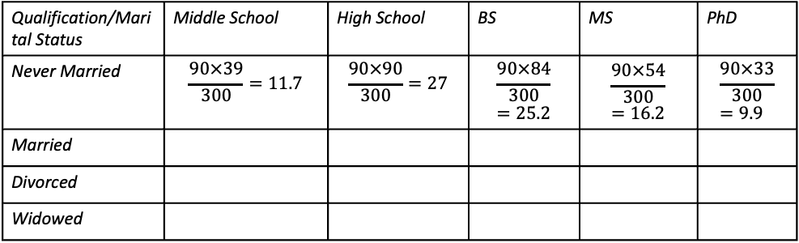

Chi-Square ${(χ}^{2})$: Example 2
$$e_{11}=\frac{row_{total}×column_{total}}{n}$$
Qualification/Marital Status | Middle School | High School | BS | MS | PhD | Total
Never Married | 18 | 36 | 21 | 9 | 6 | 90
Married | 12 | 36 | 45 | 36 | 21 | 150
Divorced | 6 | 9 | 9 | 3 | 3 | 30
Widowed | 3 | 9 | 9 | 6 | 3 | 30
Total | 39 | 90 | 84 | 54 | 33 | 300
Observed Values
Qualification/Marital Status | Middle School | High School | BS | MS | PhD
Never Married | $$\frac{90×39}{300}=11.7$$ | $$\frac{90×90}{300}=27$$ | $$\frac{90×84}{300}=25.2$$ | $$\frac{90×54}{300}=16.2$$ | $$\frac{90×33}{300}=9.9$$
Married
Divorced
Widowed
Expected Values
Credit: Vectors Academy

Slide 14
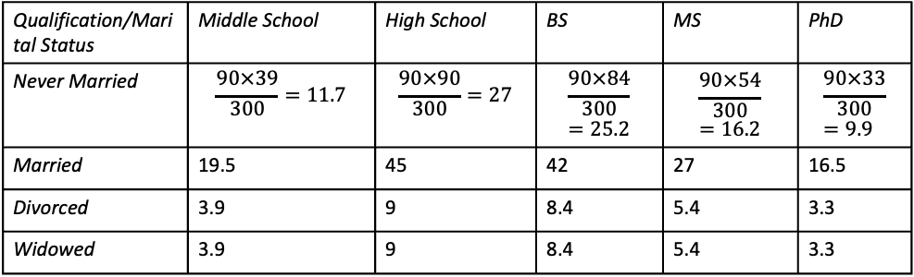
Chi-Square ${(χ}^{2})$: Example 2
$$e_{11}=\frac{row_{total}×column_{total}}{n}$$
Qualification/Marital Status | Middle School | High School | BS | MS | PhD | Total
Never Married | 18 | 36 | 21 | 9 | 6 | 90
Married | 12 | 36 | 45 | 36 | 21 | 150
Divorced | 6 | 9 | 9 | 3 | 3 | 30
Widowed | 3 | 9 | 9 | 6 | 3 | 30
Total | 39 | 90 | 84 | 54 | 33 | 300
Observed Values
Qualification/Marital Status | Middle School | High School | BS | MS | PhD
Never Married | $$\frac{90×39}{300}=11.7$$ | $$\frac{90×90}{300}=27$$ | $$\frac{90×84}{300}=25.2$$ | $$\frac{90×54}{300}=16.2$$ | $$\frac{90×33}{300}=9.9$$
Married | 19.5 | 45 | 42 | 27 | 16.5
Divorced | 3.9 | 9 | 8.4 | 5.4 | 3.3
Widowed | 3.9 | 9 | 8.4 | 5.4 | 3.3
Expected Values
Credit: Vectors Academy

Slide 15

Chi-Square ${(χ}^{2})$: Example 2
$$e_{11}=\frac{row_{total}×column_{total}}{n}$$
Qualification/Marital Status | Middle School | High School | BS | MS | PhD | Total
Never Married | 18 (11.7) | 36 (27) | 21 (25.2) | 9 (16.2) | 6 (9.9) | 90
Married | 12 (19.5) | 36 (45) | 45 (42) | 36 (27) | 21 (16.5) | 150
Divorced | 6 (3.9) | 9 (9) | 9 (8.4) | 3 (5.4) | 3 (3.3) | 30
Widowed | 3 (3.9) | 9 (9) | 9 (8.4) | 6 (5.4) | 3 (3.3) | 30
Total | 39 | 90 | 84 | 54 | 33 | 300
Observed Values
(Expected Values)
$$χ^{2}=23.57$$
$$Degree of Freedom=\left(columns−1\right)×(rows−1)$$
$$Degree of Freedom=\left(5−1\right)×\left(4−1\right)=4×3=12$$
Credit: Vectors Academy

Slide 16





Chi-Square ${(χ}^{2})$: Example 2
$$χ^{2}=23.57$$
$$Degree of Freedom=12$$
$$Significance Level \left(∝\right)=0.05 (5\%)$$
$$χ_{calculated}^{2}>χ_{tabular}^{2}$$
$∴$we reject Null hypothesis and accept alternate hypothesis
Credit: Vectors Academy
Notes:
In a chi-square test, the significance level (alpha, α) represents the acceptable risk of incorrectly rejecting a true null hypothesis, typically set at 0.05 (5%). A small p-value (p ≤ α) indicates a statistically significant association or deviation, allowing you to reject the null hypothesis, while a large p-value (p > α) means there's not enough evidence to reject the null hypothesis.
What the Significance Level Means
Risk of Error:
The significance level is the probability of making a Type I error (false positive)—concluding that an effect exists when it doesn't.
By Convention:
A significance level of 0.05 (or 5%) is a common choice in statistics, meaning you're willing to accept a 5% chance of a false positive.
Trade-Offs:
A lower alpha (e.g., 0.01) reduces the risk of Type I errors but increases the risk of a Type II error (false negative), and vice versa.
How to Use It in a Chi-Square Test
Choose Alpha: Before conducting the test, select a significance level (e.g., α = 0.05).
Get Your P-Value: Perform the chi-square test to obtain a p-value, which is the probability of observing the data (or more extreme data) if the null hypothesis were true.
Compare P-Value to Alpha:
If p ≤ α: Reject the null hypothesis. There is a statistically significant association or deviation.
If p > α: Fail to reject the null hypothesis. There is not enough statistical evidence to conclude that there is an association or deviation.

